Slide 1
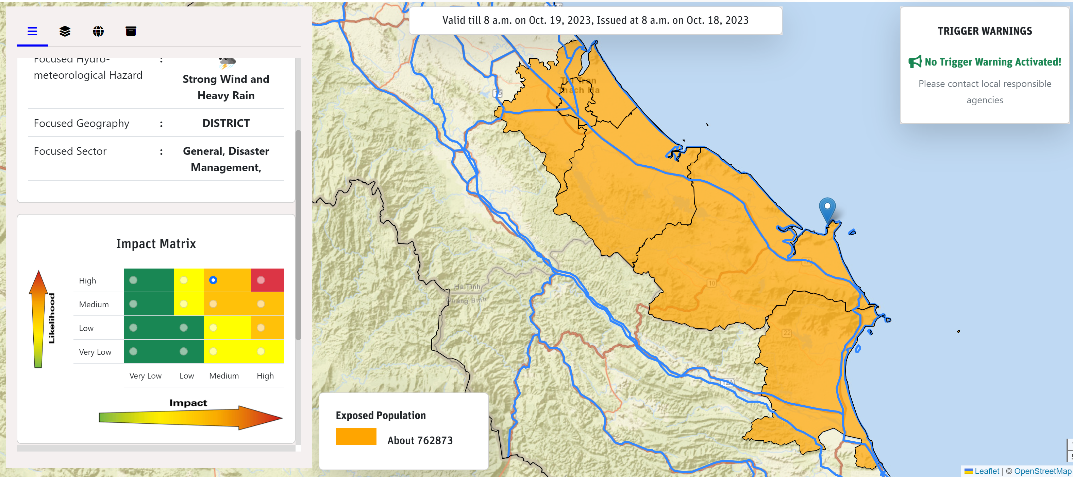
IMPACT-BASED FORECASTING AND WARNING SYSTEM (IbFWS)
The Future of Forecast and Warning
18th IWS/4th TRCG Forum
28 Nov - 01 Dec 2023
Senaka Basnayake, PhD
Asian Disaster Preparedness Center

Slide 2
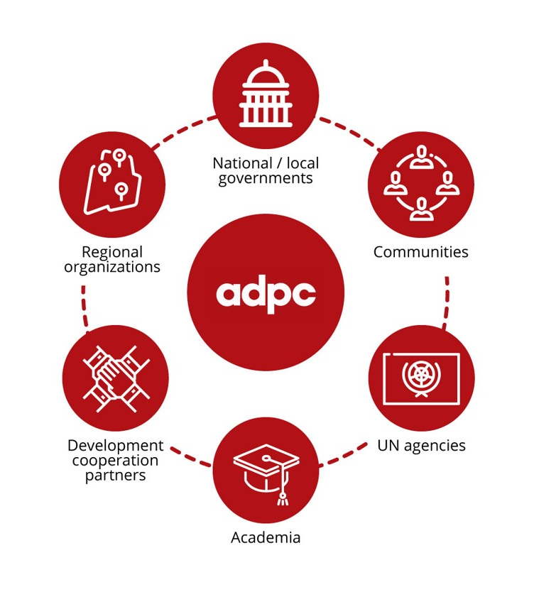
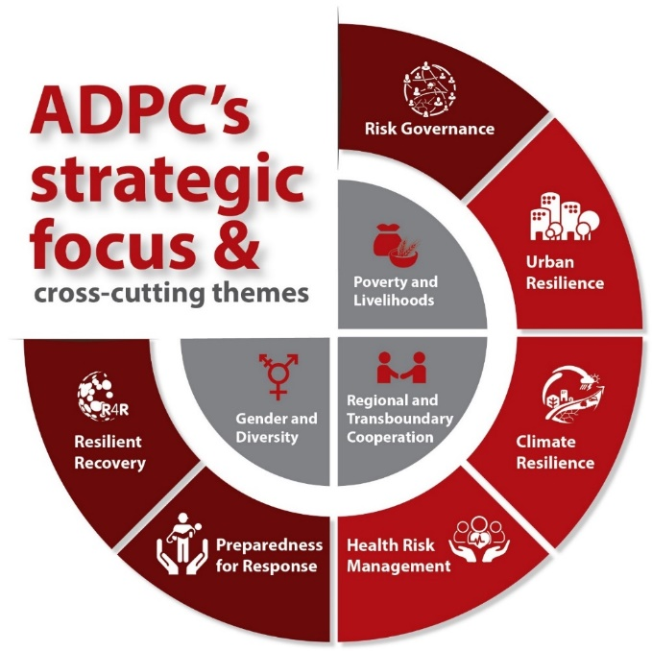
Introduction:
Asian Disaster Preparedness Center (ADPC)
Autonomous International Organization
Partnerships:
37 years
Over
of experiences in DRR & CR
Offices and representations:
Bangkok, Thailand
Dhaka, Bangladesh
Yangon, Myanmar
Colombo, Sri Lanka
Phnom Penh, Cambodia
Jakarta, Indonesia
Bihar, India
Kathmandu, Nepal
Manila, Philippines
Hanoi, Viet Nam
Addis Ababa, Ethiopia
Safer communities and sustainable development through disaster risk reduction

Slide 3
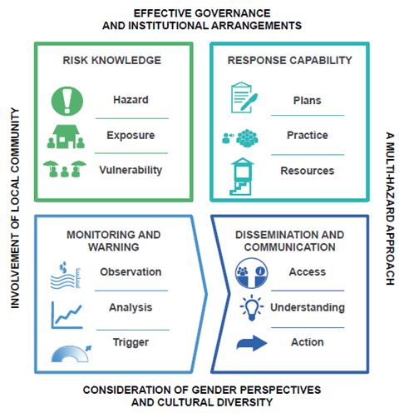
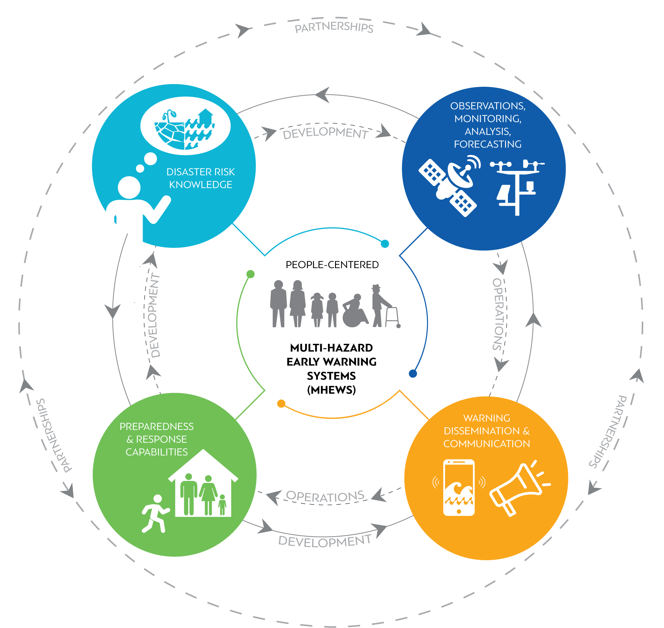
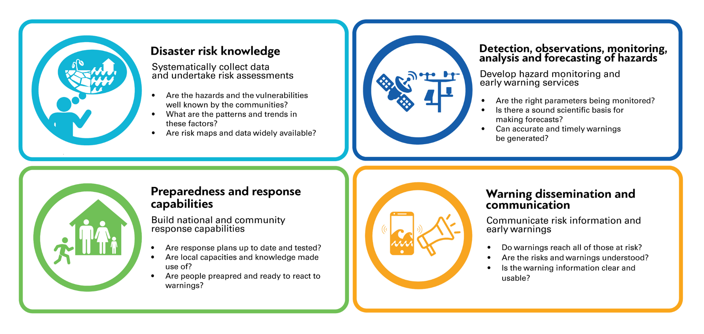
Elements of an effective EWS:
Source: Practical Action adapted from World Meteorological Organization (2017)

Slide 4
Impact-based Forecasting and Warning (IbFW):
Source: UK Met (2020)

Slide 5
Definition of IbFW:
IbFW is a structured approach for combining hazard, exposure, and vulnerability data to identify risk and support decision-making, with the ultimate objective of encouraging early action that reduces damages and loss of life from natural hazards.
IbFW provides the information needed to minimize the socio-economic costs of weather and climate hazards. Organizations and individuals can make critical decisions to ensure that resources and supplies are in place to take early action and to respond as soon as it is safe to do so.

Slide 6
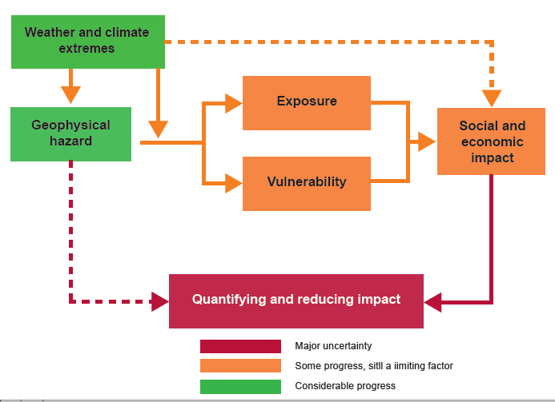
Key Elements of an IbFW:
Source: WMO (2015)

Slide 7
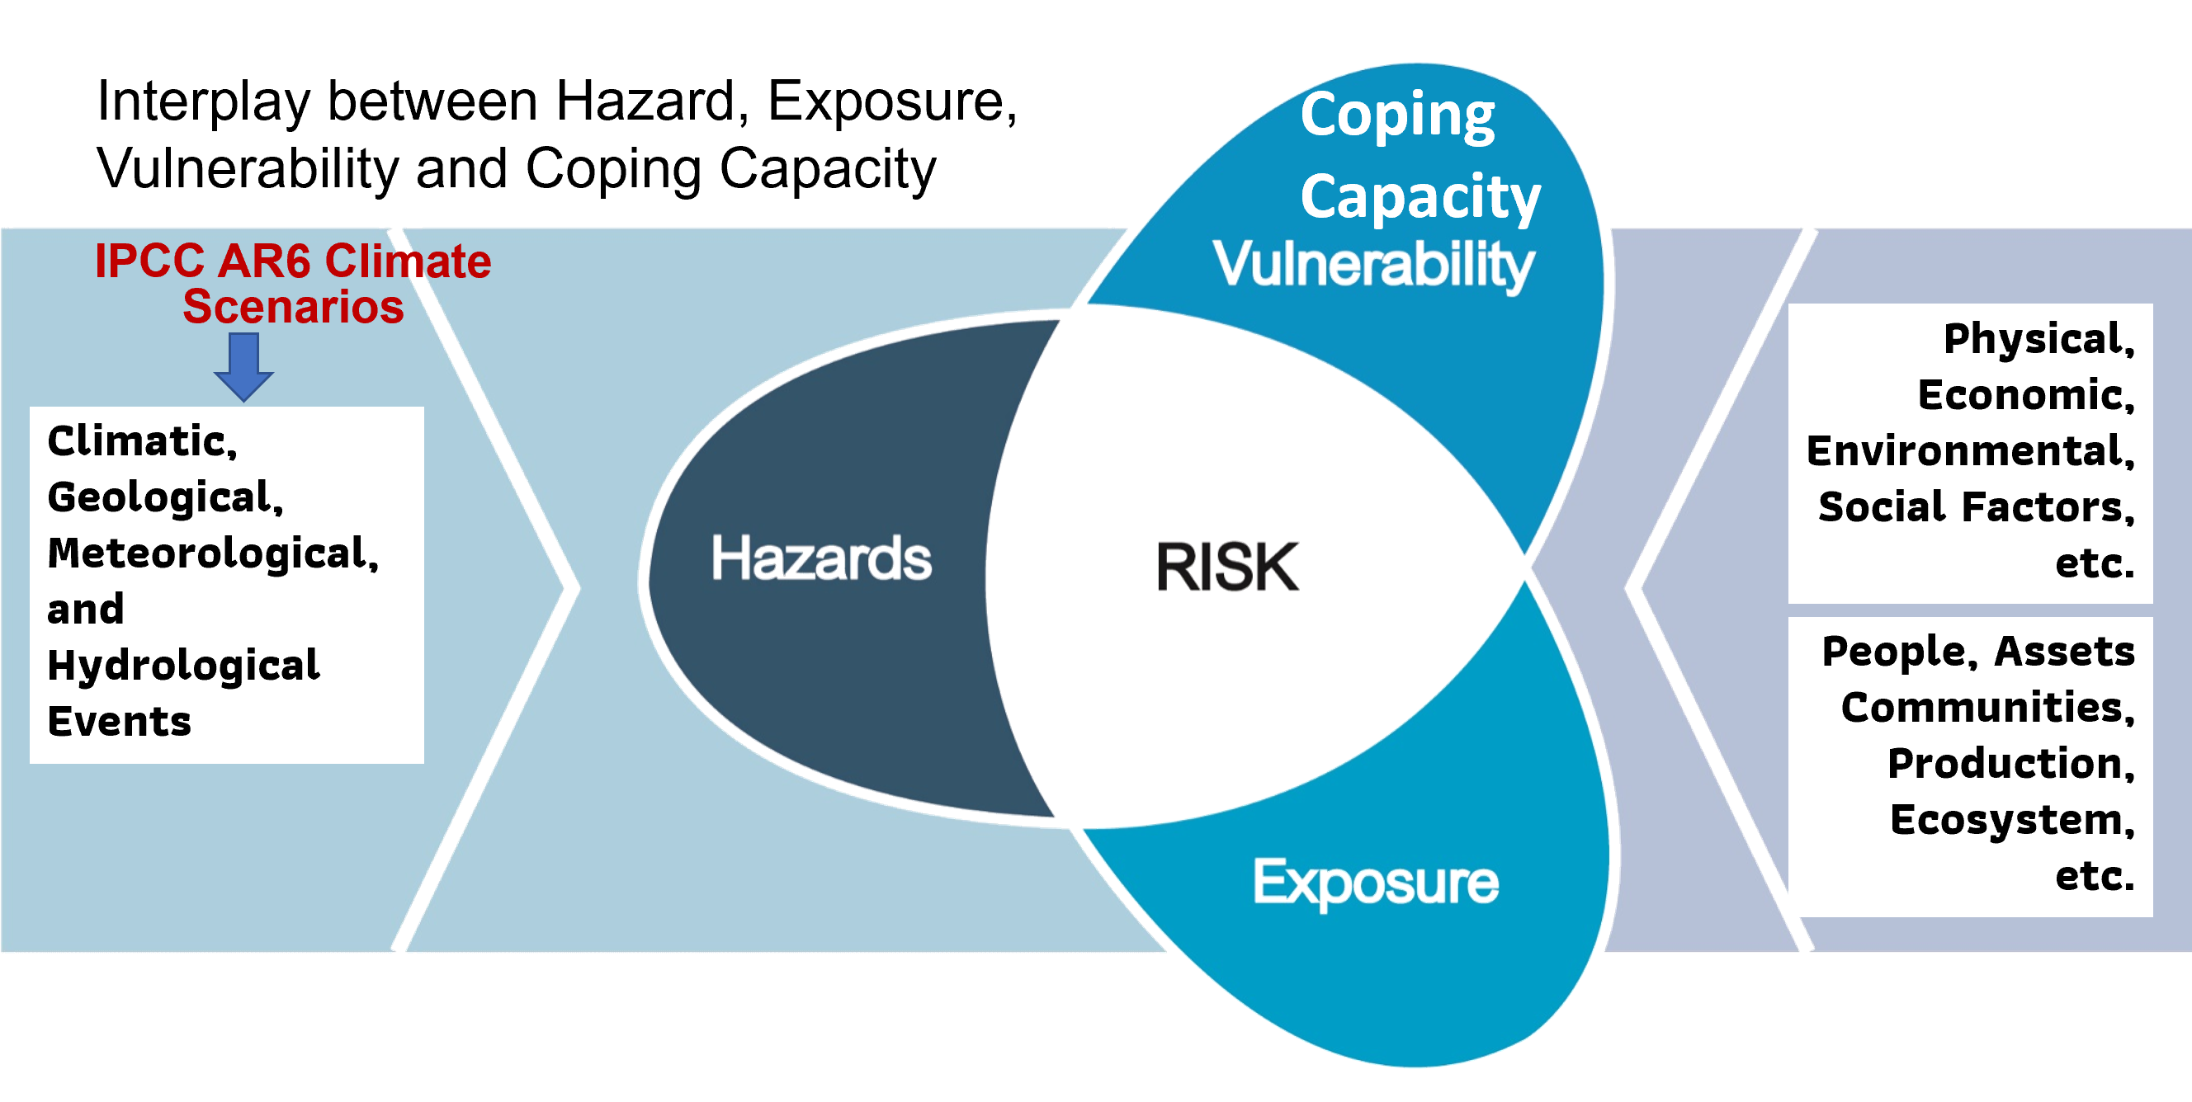
Understanding Risk and Linking Impact:
Source: IPCC

Slide 8
Key Steps for IbFW:
Stakeholder mapping and Assessment of IBFW understanding level
IBFW Generation
Forecast/Impact Verification
01
02
03
04
05
06
Level of Understanding about IBFW
Risk and Impact Assessment
IBFW Dissemination
Codesign IbFW
Coproduce IbFW
Deliver IbFW

Slide 9
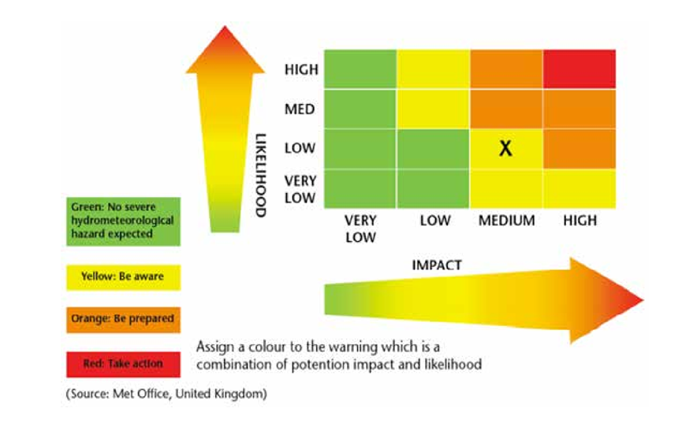
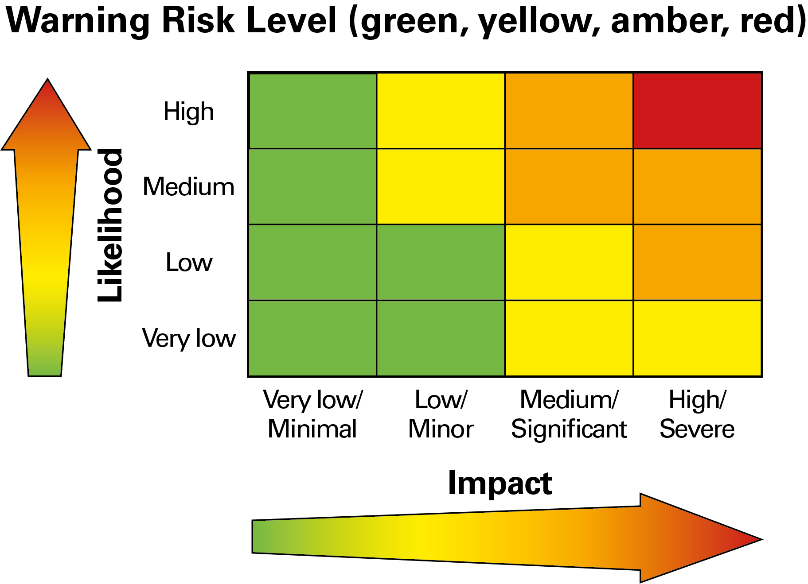
IbFW Matrix:

Slide 10
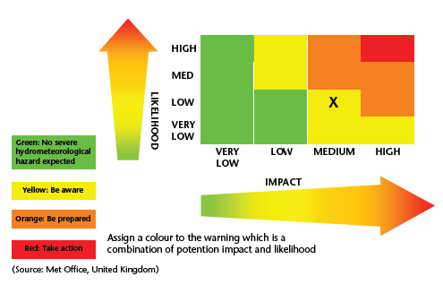
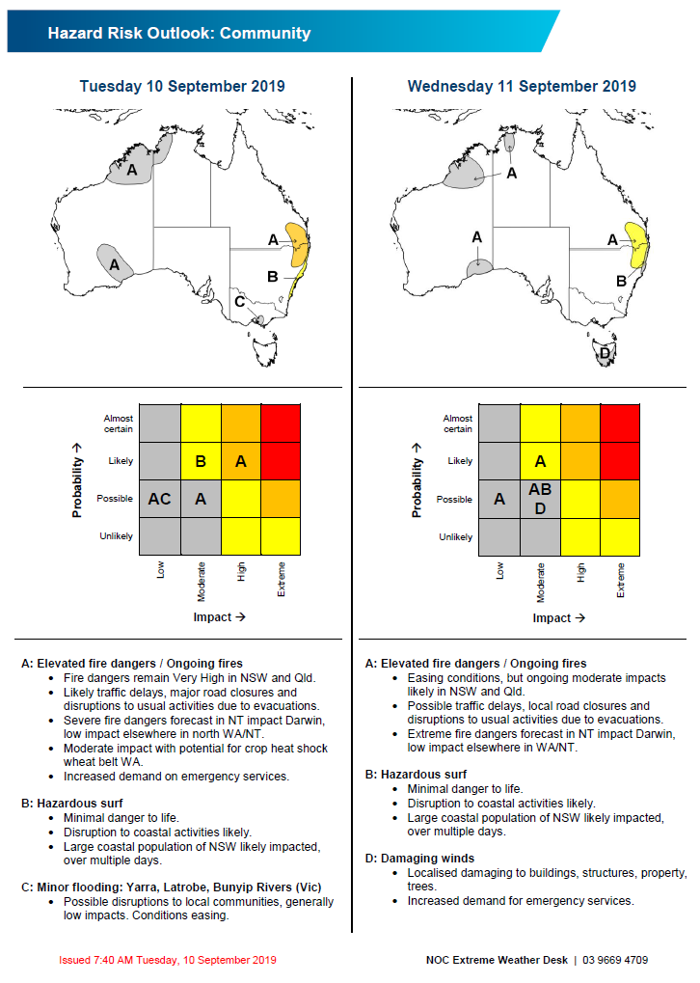
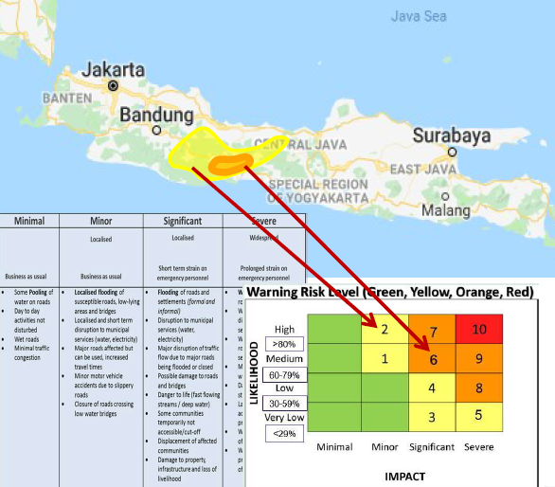
Localization of IbFW Matrix:
WMO/UK Met
BMKG
BOM

Slide 11
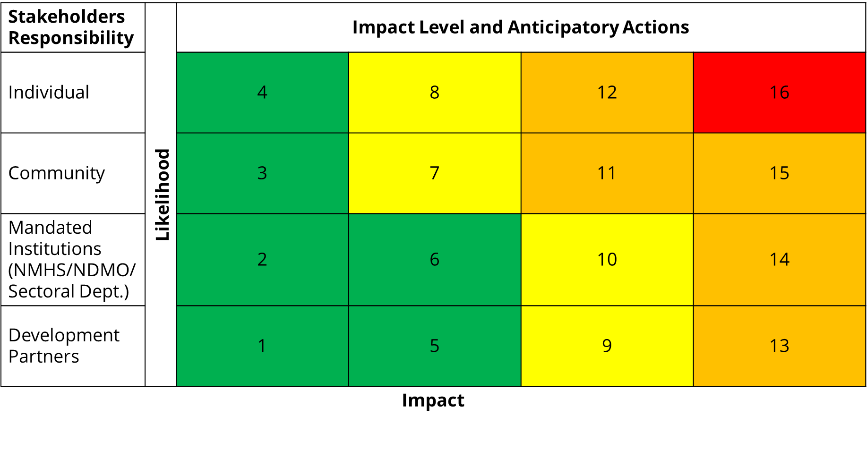
Localization of IbFW Matrix:

Slide 12
Understand the IbFW with a Tropical Cyclone

Slide 13
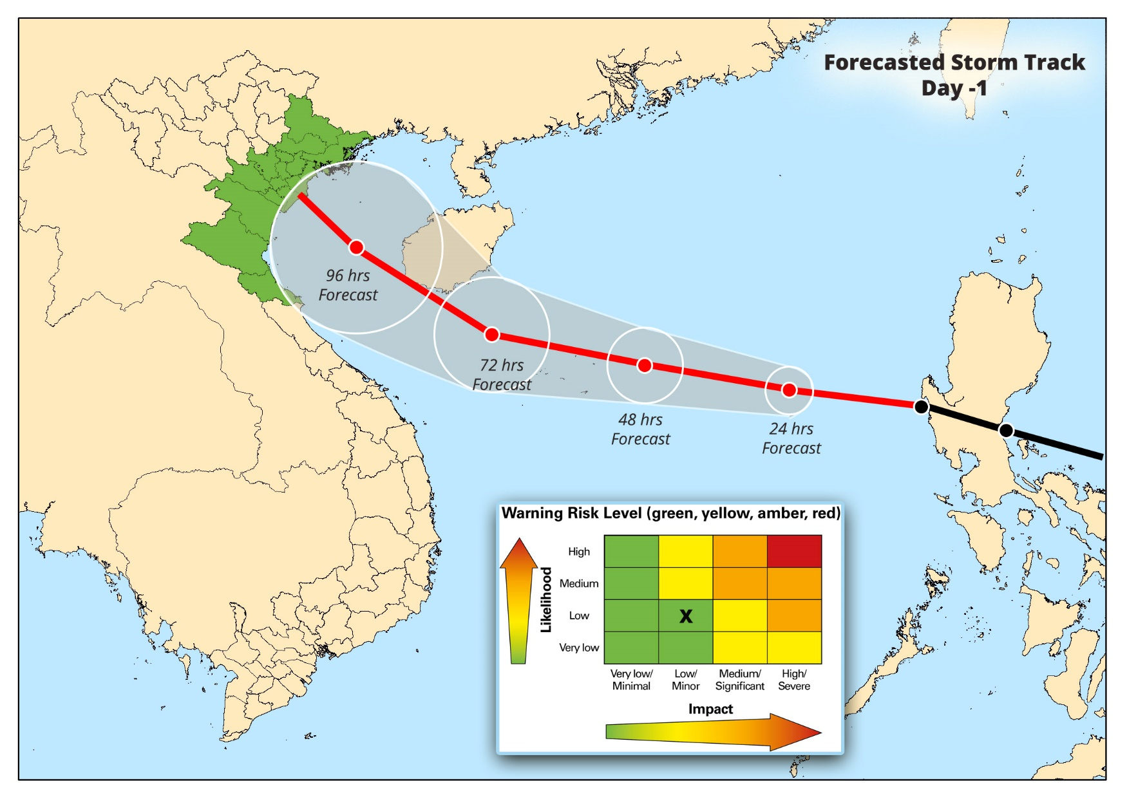
Larger scale: Qualitative Information
No Severe Event Hazard Expected
Impact:
Impacts are not yet visible as the Typhoon is far away from Vietnam
Actions and AA:
Keep an eye on the weather forecasts
Watch TV,
Listen radio,
Look at Social Media

Slide 14
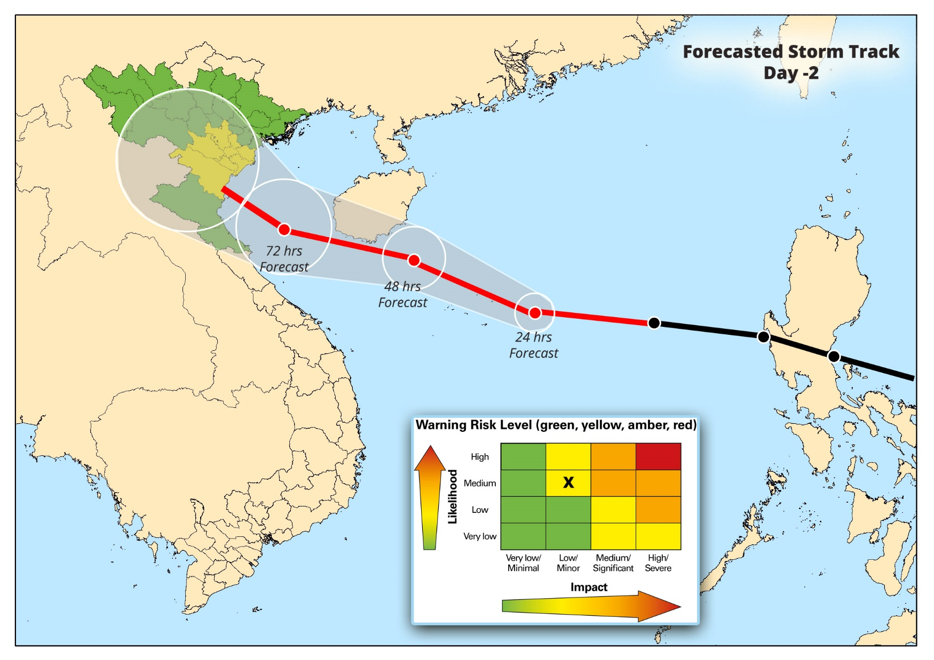
Larger scale: Qualitative Information
Be Aware
Impact:
Trees blown away (Isolated)
Damages to billboards (Isolated)
Small scale damage to vegetation (Isolated)
Roofs of non-engineered houses damaged (tin roof, thatch roof)
Falling lamp posts
Actions and AA:
Remain alert
Ensure you access the latest weather forecast for up-to-date information
Prepare to act to protect life and livelihood in the designated locations,
Prepare to act to protect livestock in the designated locations
Prepare to act to protect property in the designated locations
Identify the safe shelters with basic amenities for male and female and access to disabled

Slide 15
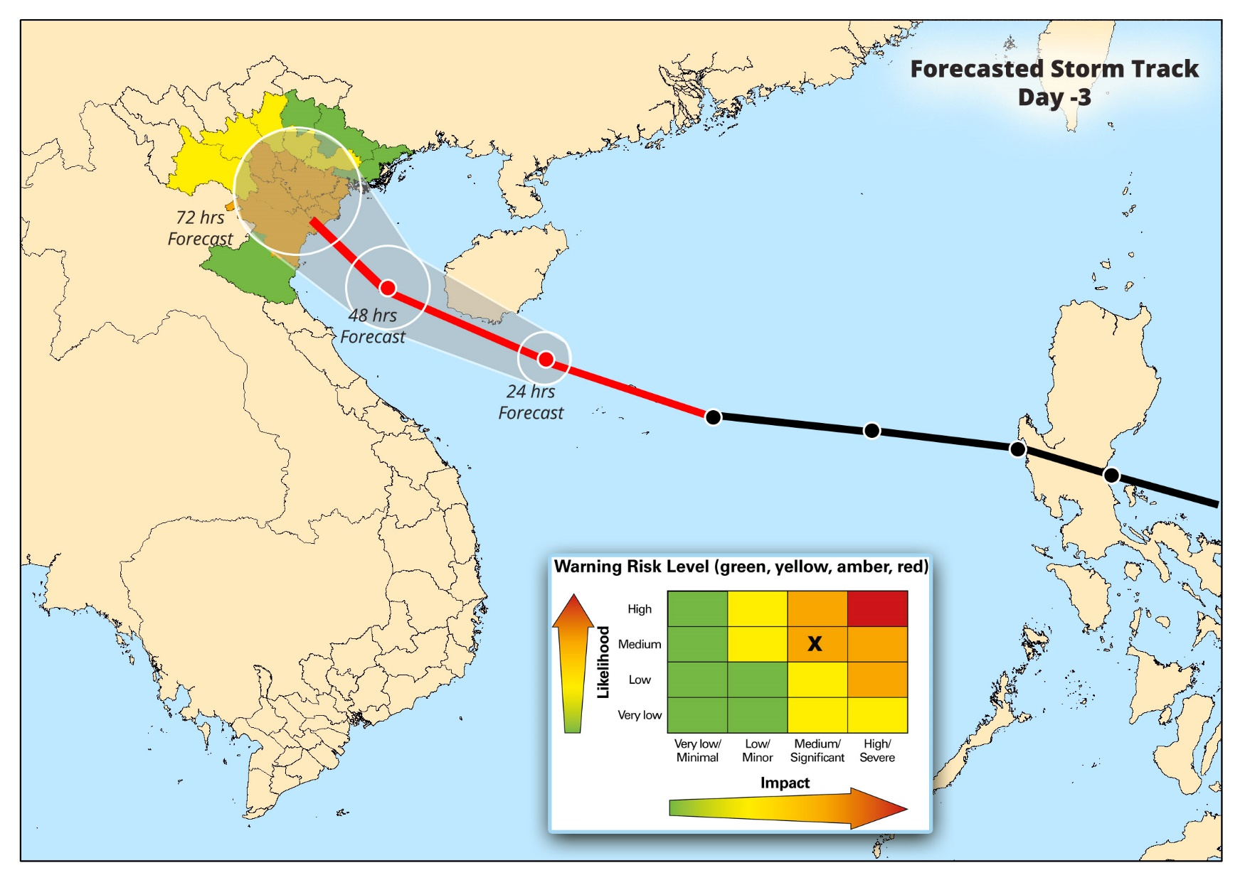
Larger scale: Qualitative Information
Be Prepared
Impact:
Trees blown over (Isolated)
Damages to billboards (Isolated)
Small scale damage to vegetation (Isolated)
Roofs of non-engineered houses damaged (tin roof, thatch roof)
Falling lamp posts
More trees blown over in larger areas that block roads
More damage to agriculture
Small boats affected that are used for transport and fishing
Engine boats can still operate
Some electricity poles damaged, causing minor outages
More vulnerable houses collapse
Significant damage to roofs of many houses
Population displacement
Actions and AA:
Remain alert
Ensure you access the latest weather forecast for up-to-date information
Prepare to act to protect life and livelihood in the designated locations,
Prepare to act to protect livestock in the designated locations
Prepare to act to protect property in the designated locations
Identify the safe shelters with basic amenities for male and female and access to disabled
Secure property and livelihood assets.
Be prepared to evacuate
Be aware of the potential risk of flying objects in your area
Follow civil protection orders
Maintain radio/media watch for latest updates

Slide 16
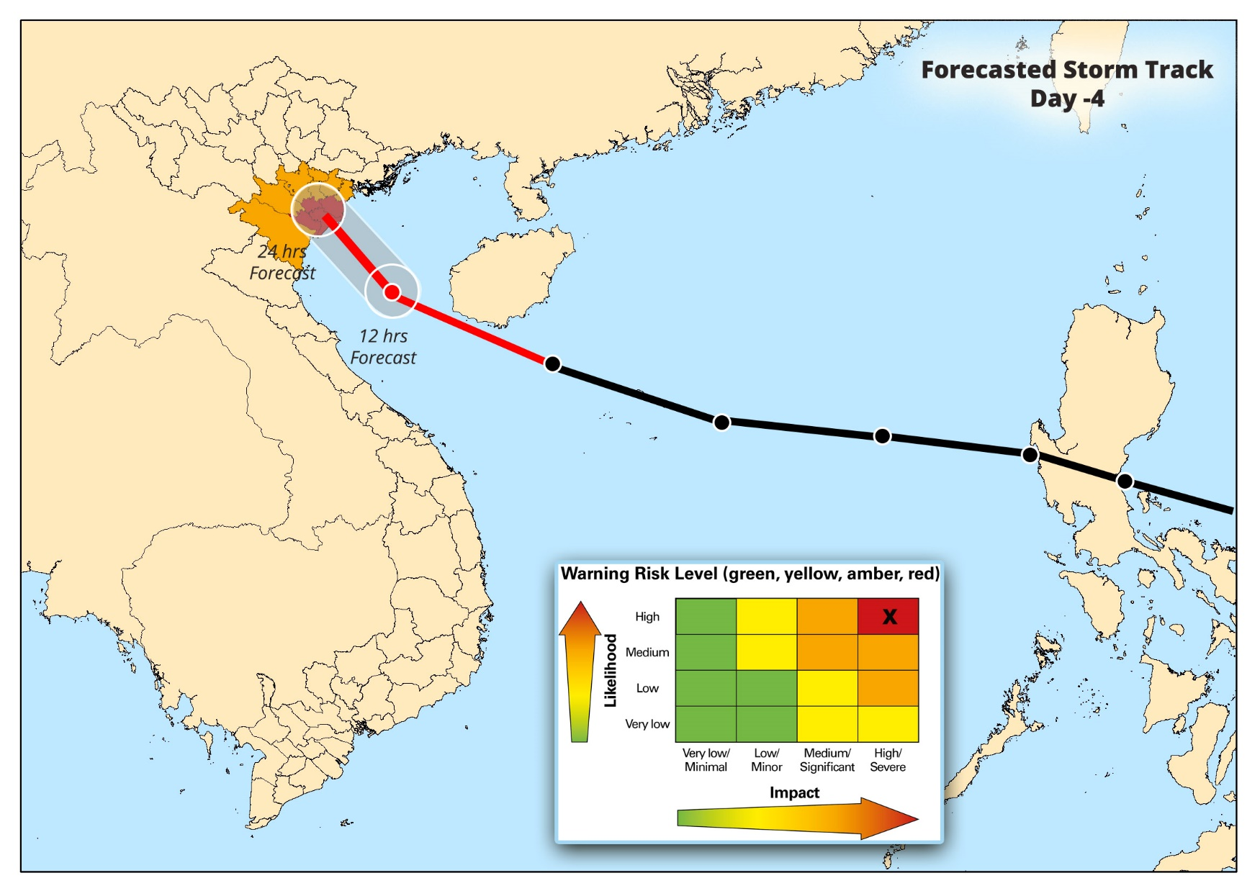
Larger scale: Qualitative Information
Take Actions
Impact:
(Previous impacts +)
Widespread damage to structures – houses and commercial buildings collapsing
Widespread damage to infrastructure systems and services (shelter, transportation, schools, hospitals, energy supply, communication)
Widespread damage to communication and electricity supply infrastructure
Widespread delays to public transportation (Air, Road, Rail, Ship, Ferry)
Loss of life of both people and animals
Big trees fall down
No more boats can operate, even big ships grounded
Schools, hospitals and many public services, damaged and some cannot be used
Loss of measurement equipment
Widespread Loss of fishing boats and gear
Financial losses to farmers and fishermen
Crops, loss yield & cultivation
Soil erosion
Search and rescue impacted on a large scale
Actions and AA:
(Previous actions +)
Evacuate if ordered to do so by disaster management authority
Be prepared for extraordinary measures to protect life and property
Be prepared with pre-arranged finance, food, medicine, shelter etc.

Slide 17
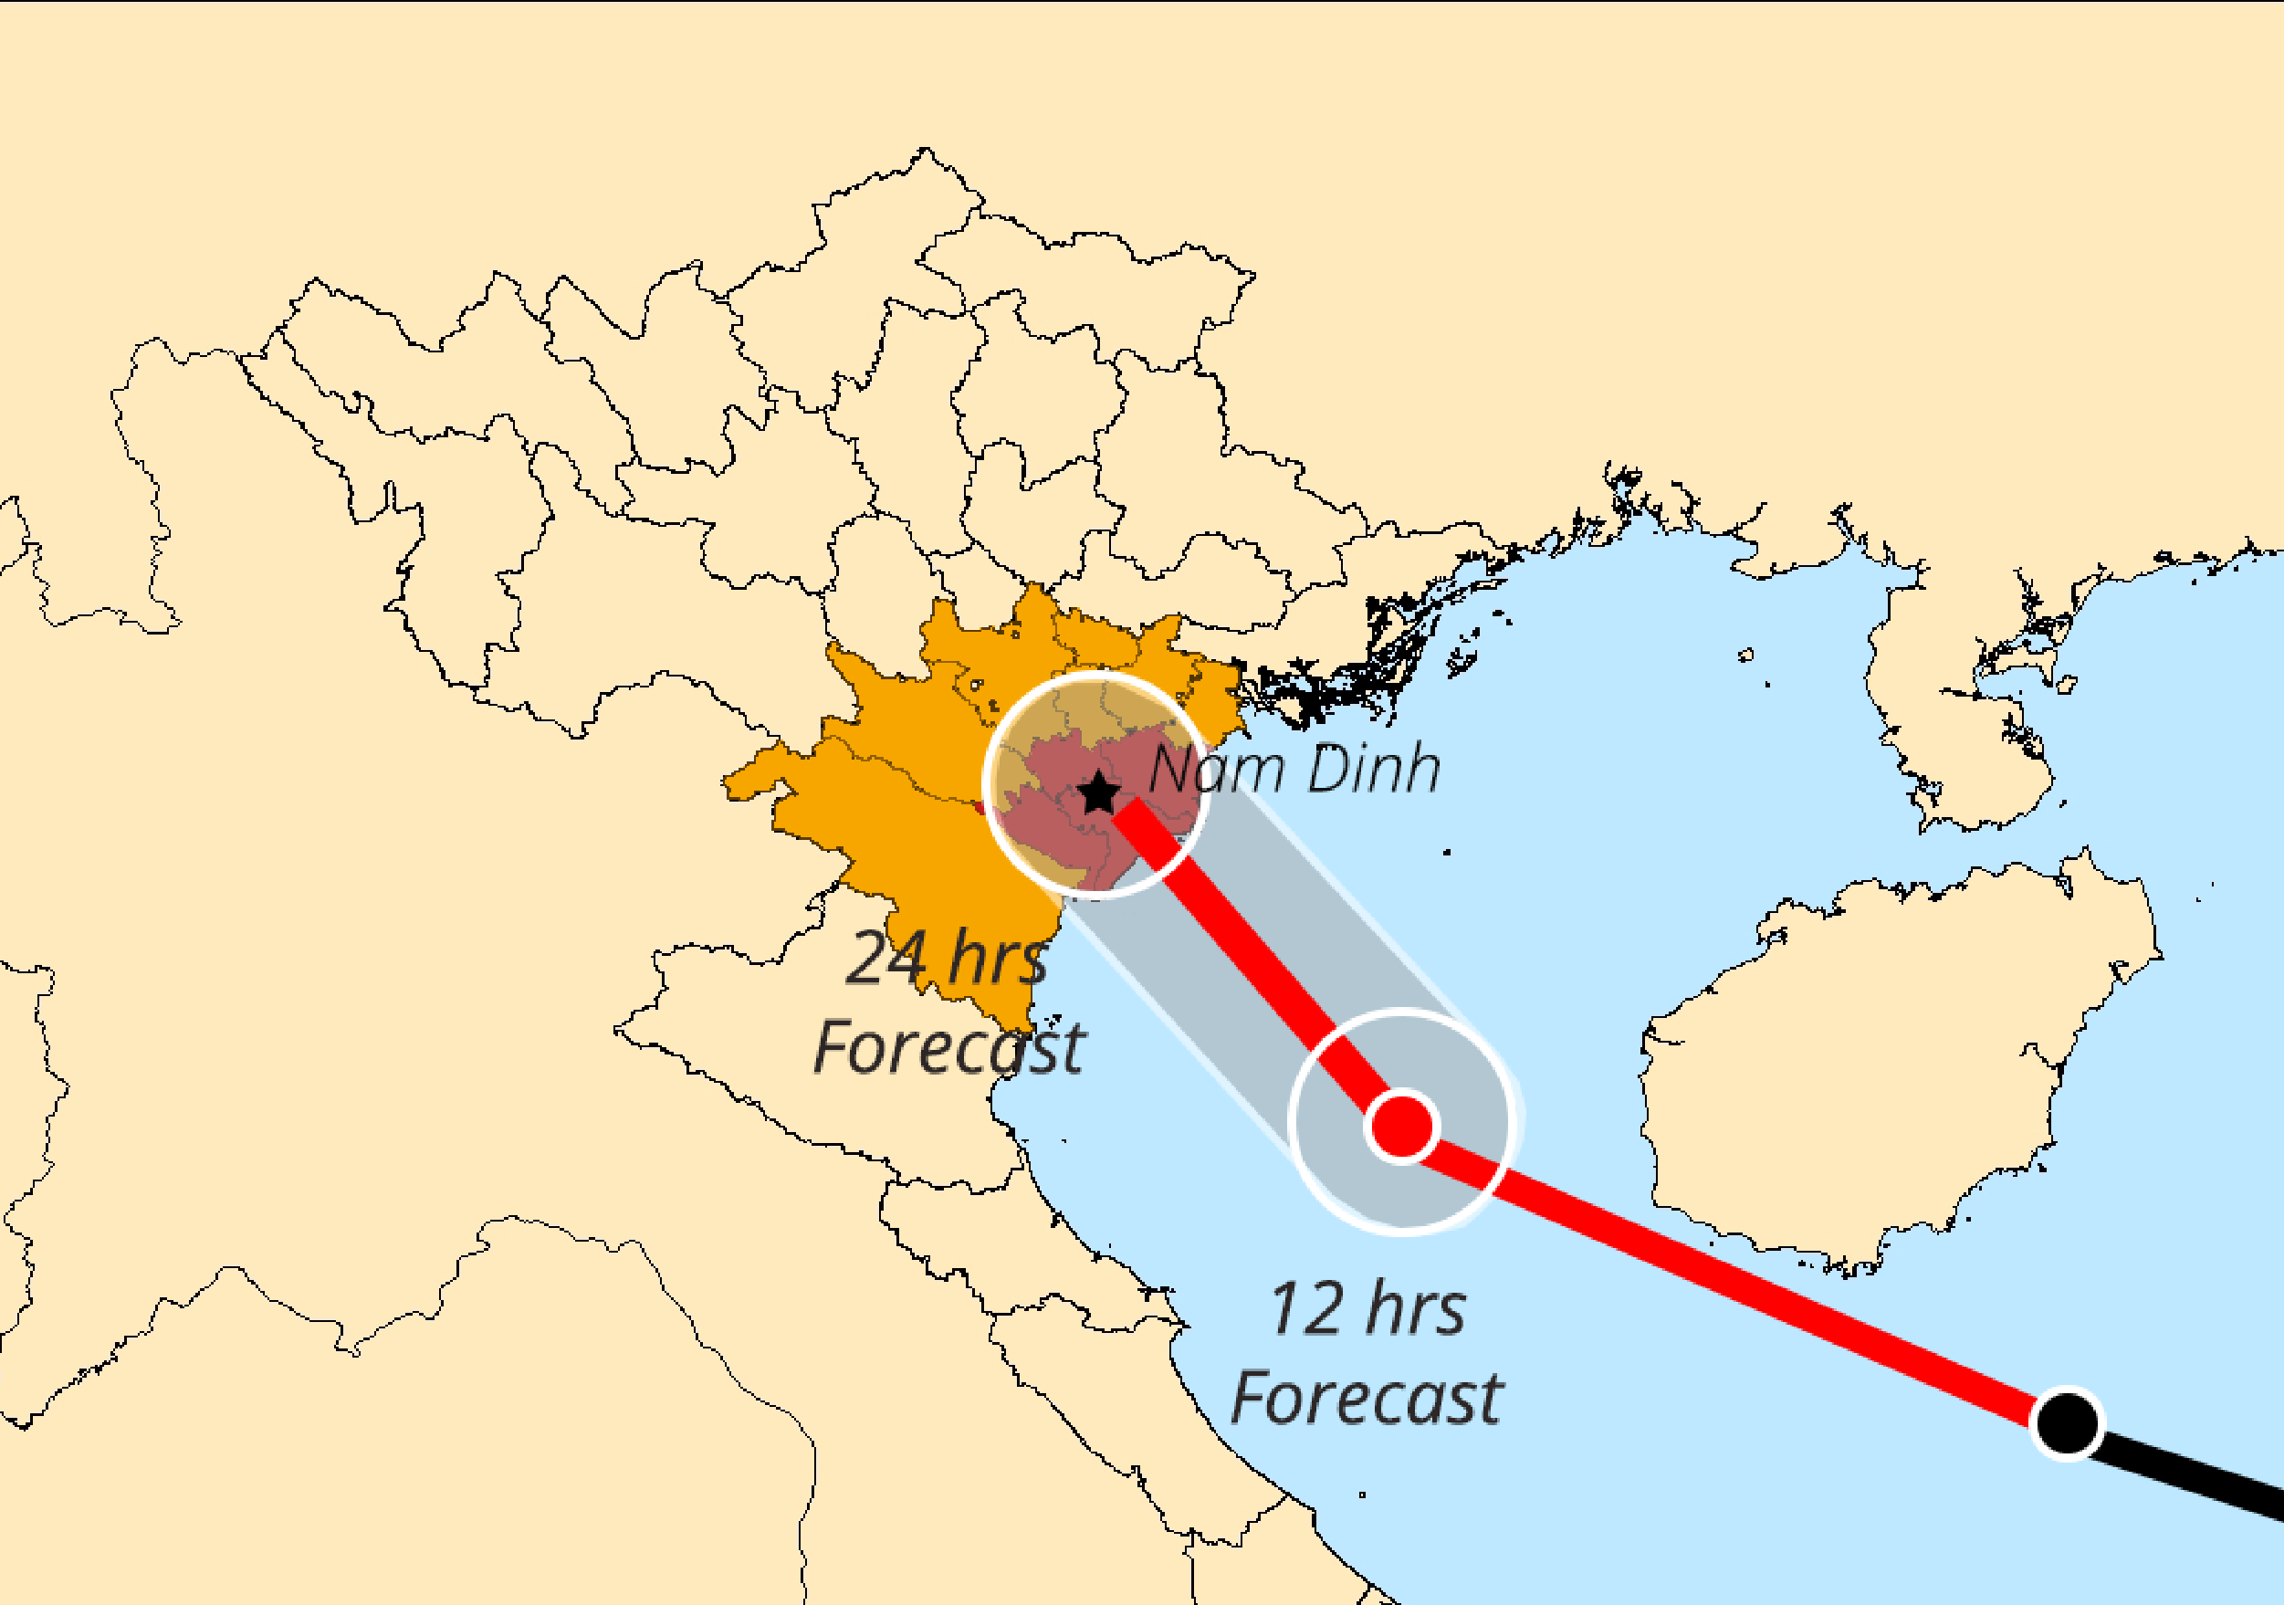
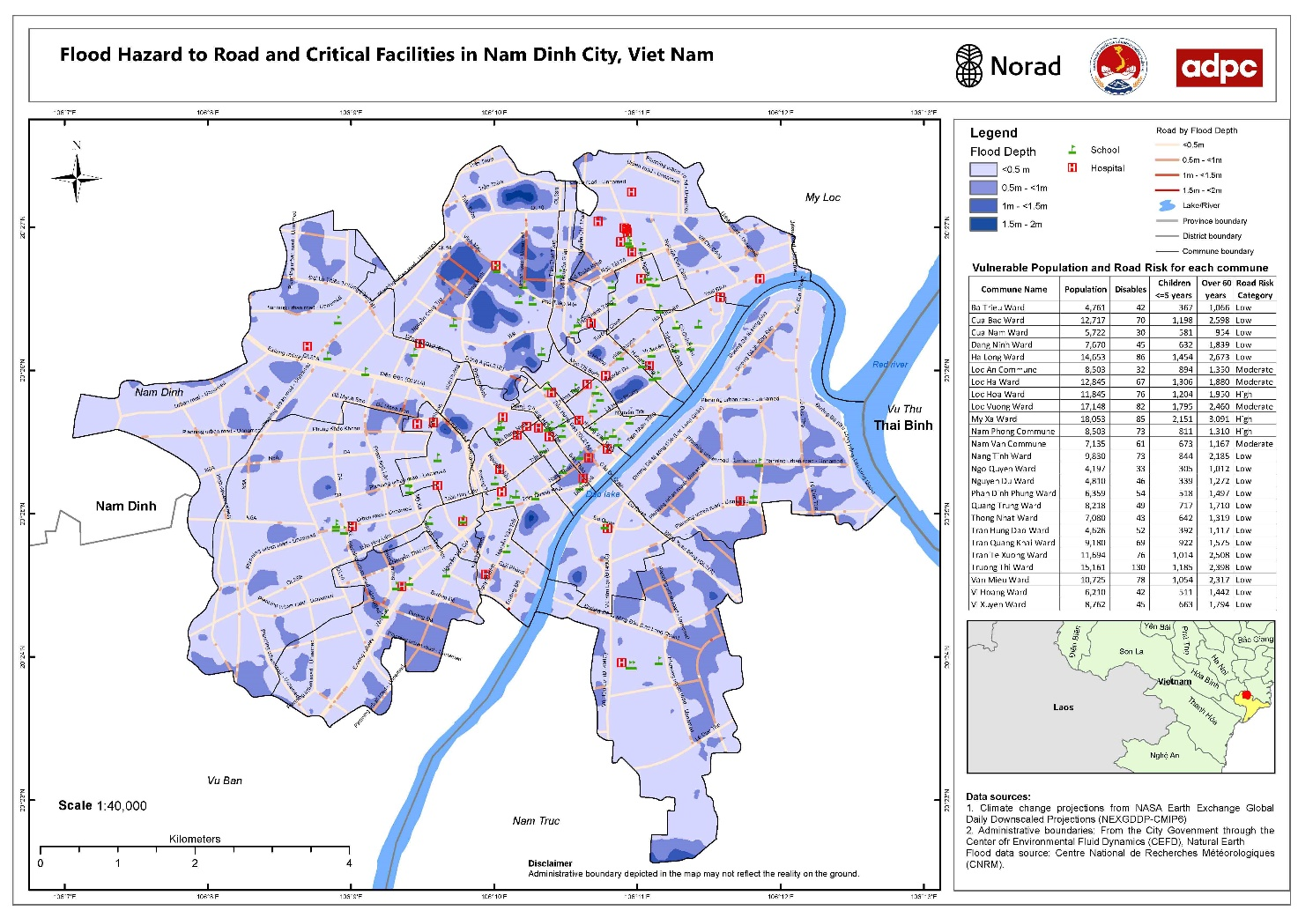
Secondary Impacts in Urban Scale: Detailed risk assessments are important for right actions

Slide 18
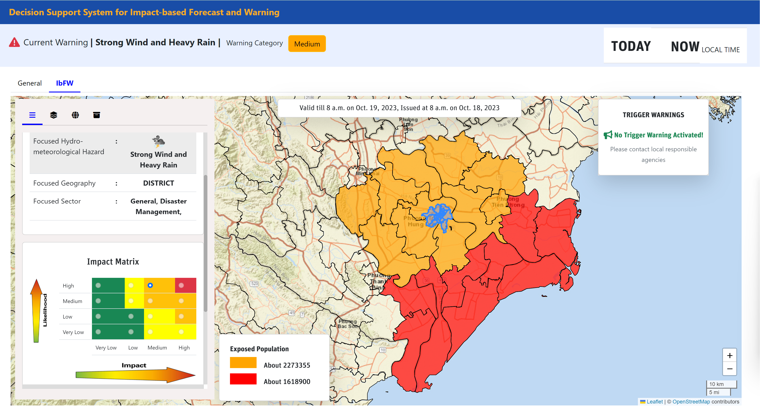

Slide 19
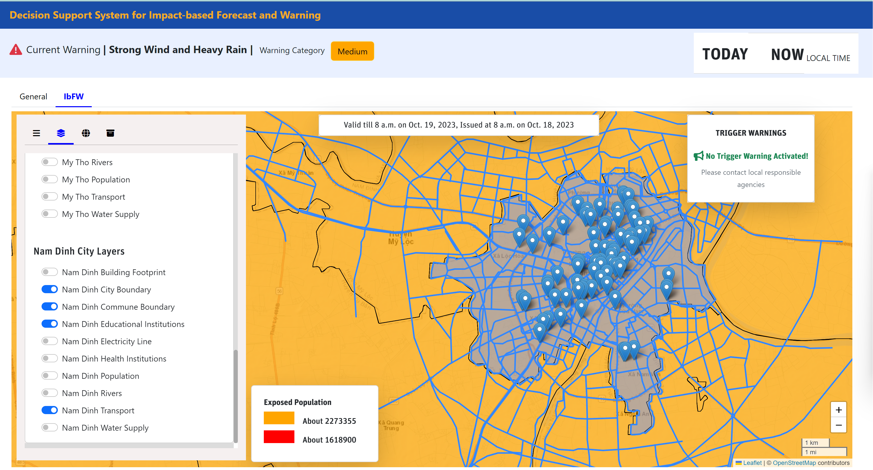
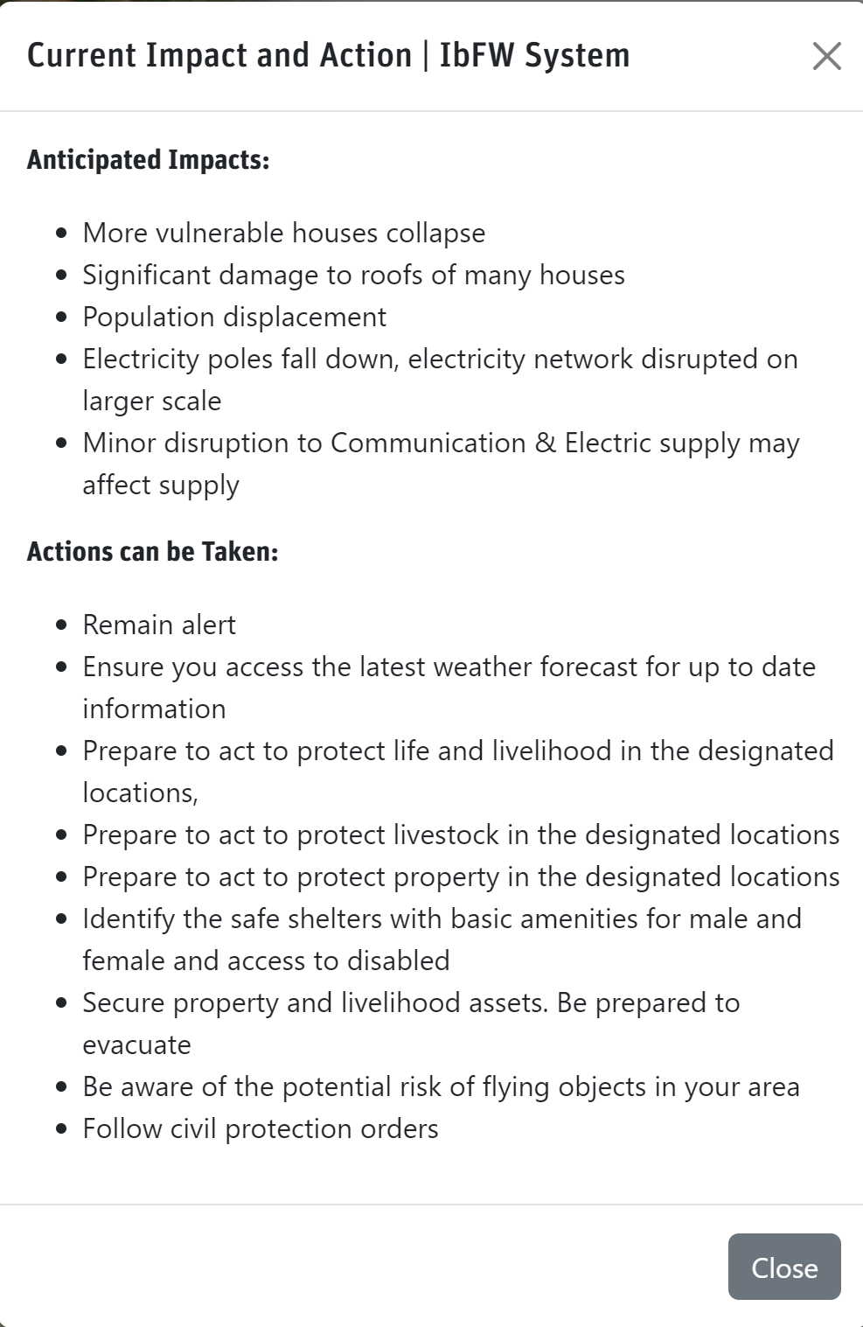
Focused Area: Quantitative Information
Roads A1, A2 and B2 over Ward 1, 2 and 3 may get flooded up to 2 feet (50%)
Houses/Buildings are more vulnerable in Ward 1, 2 and 3 (30%)
Significant damages to the roof of many houses in Ward 1 and 2 (60%)
Population displacements in Ward 1 and 2 (80%)
Electricity network disruption in Ward 1, 2 and 3

Slide 20
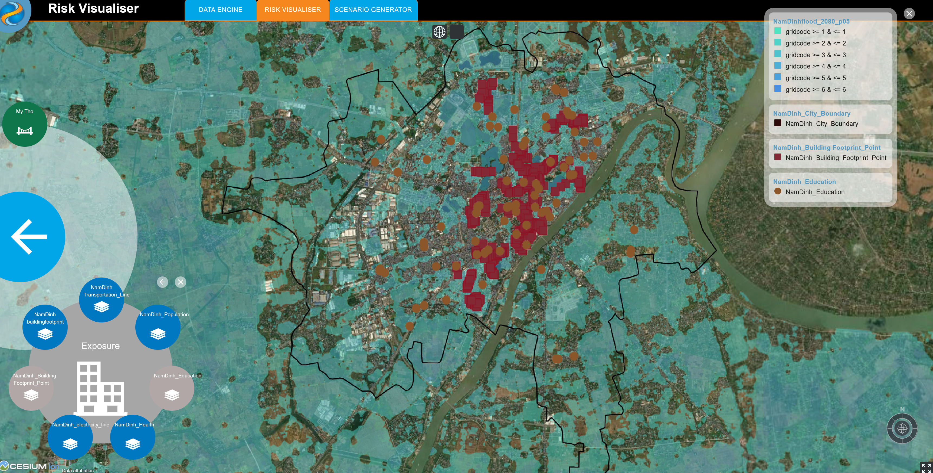

Slide 21
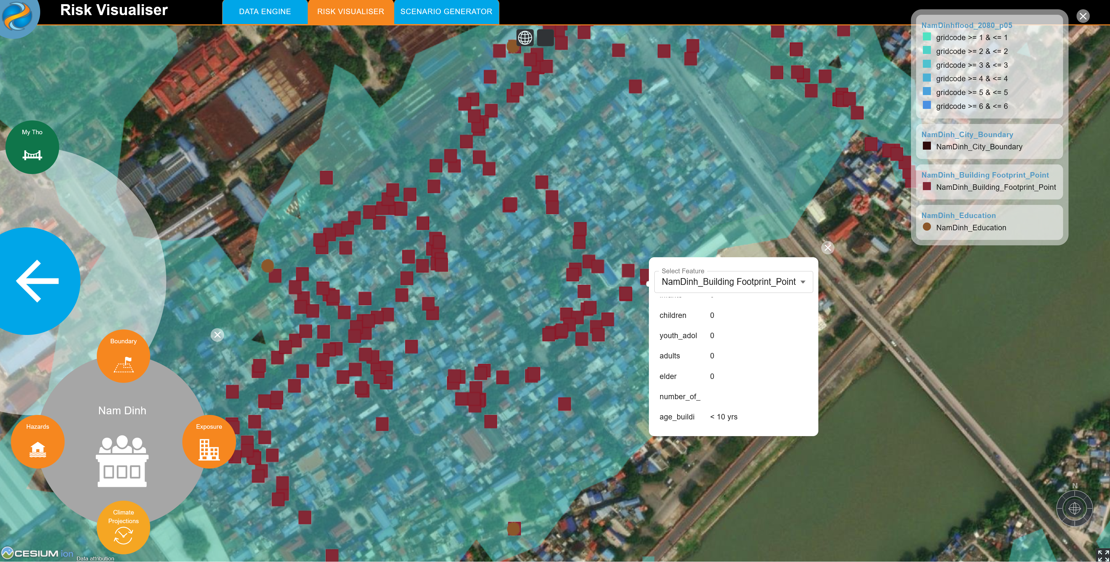

Slide 22
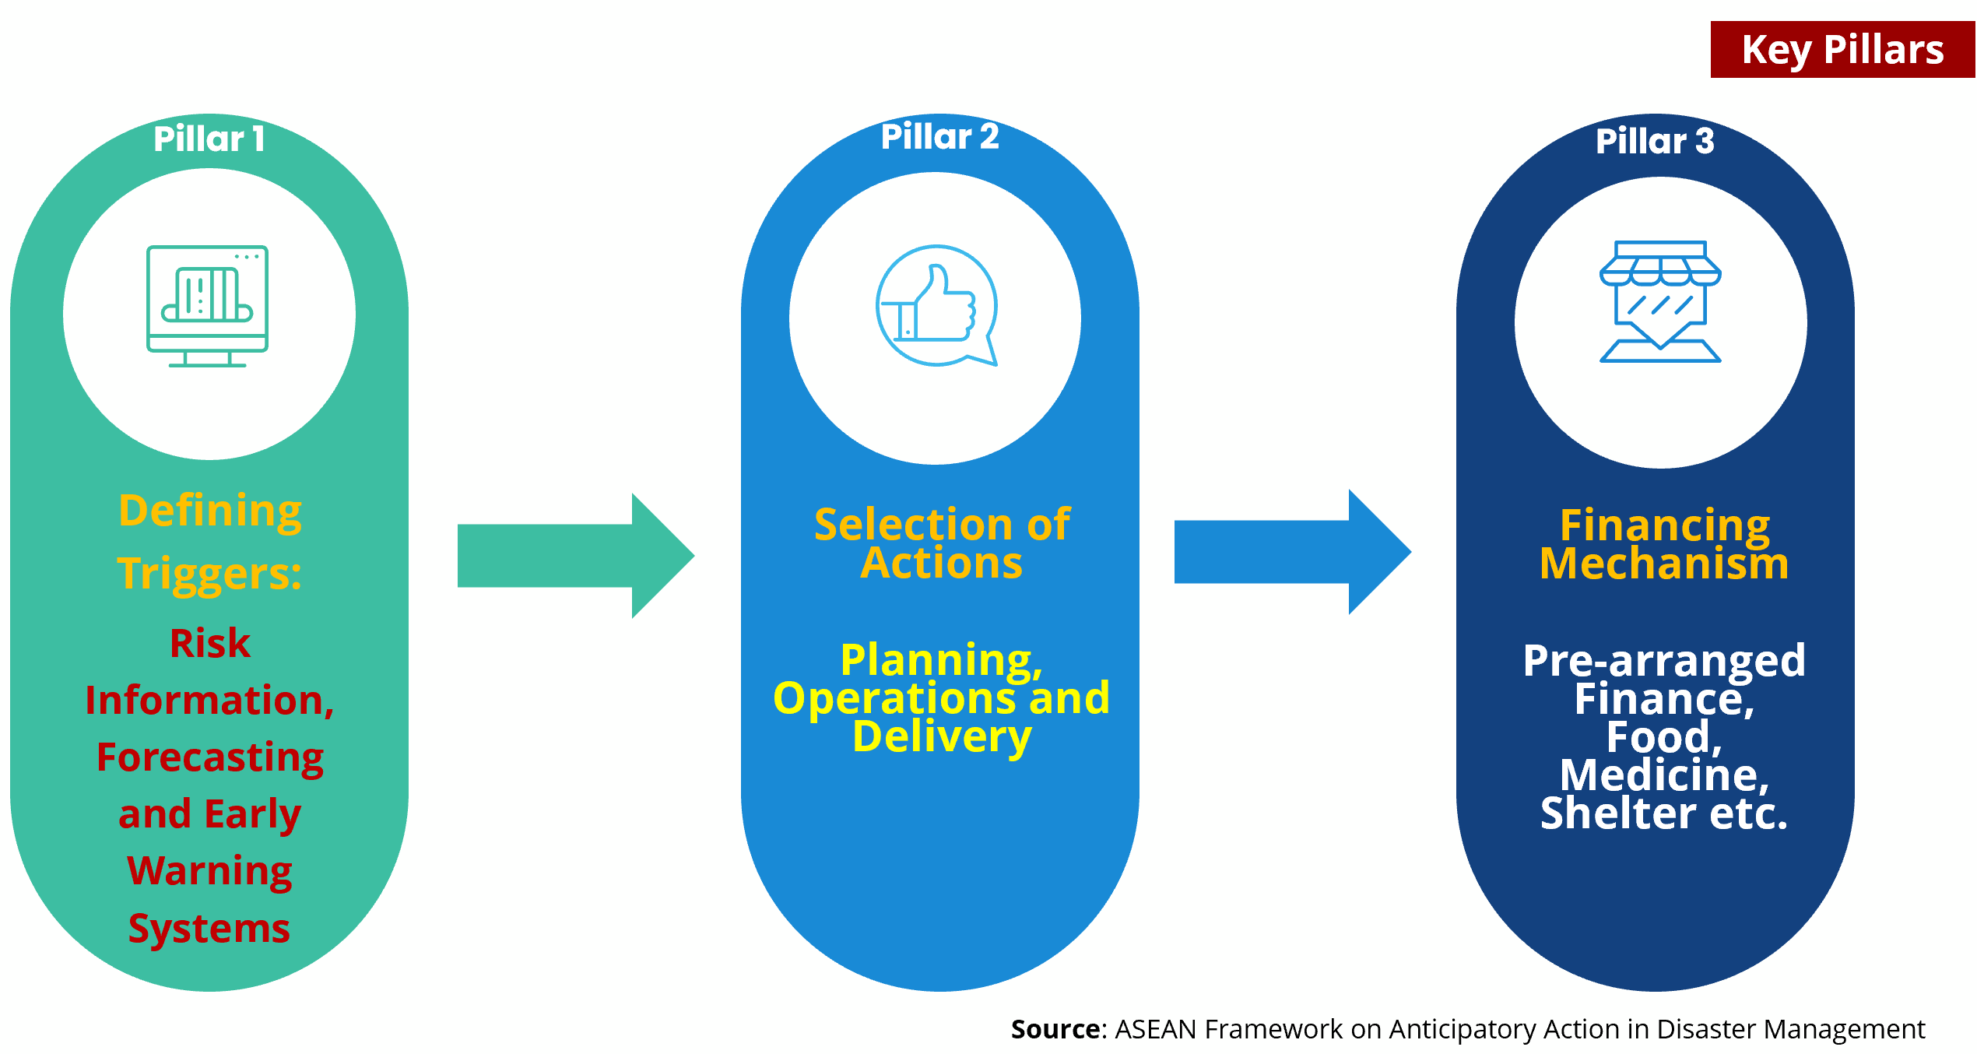
Anticipatory Actions:

Slide 23
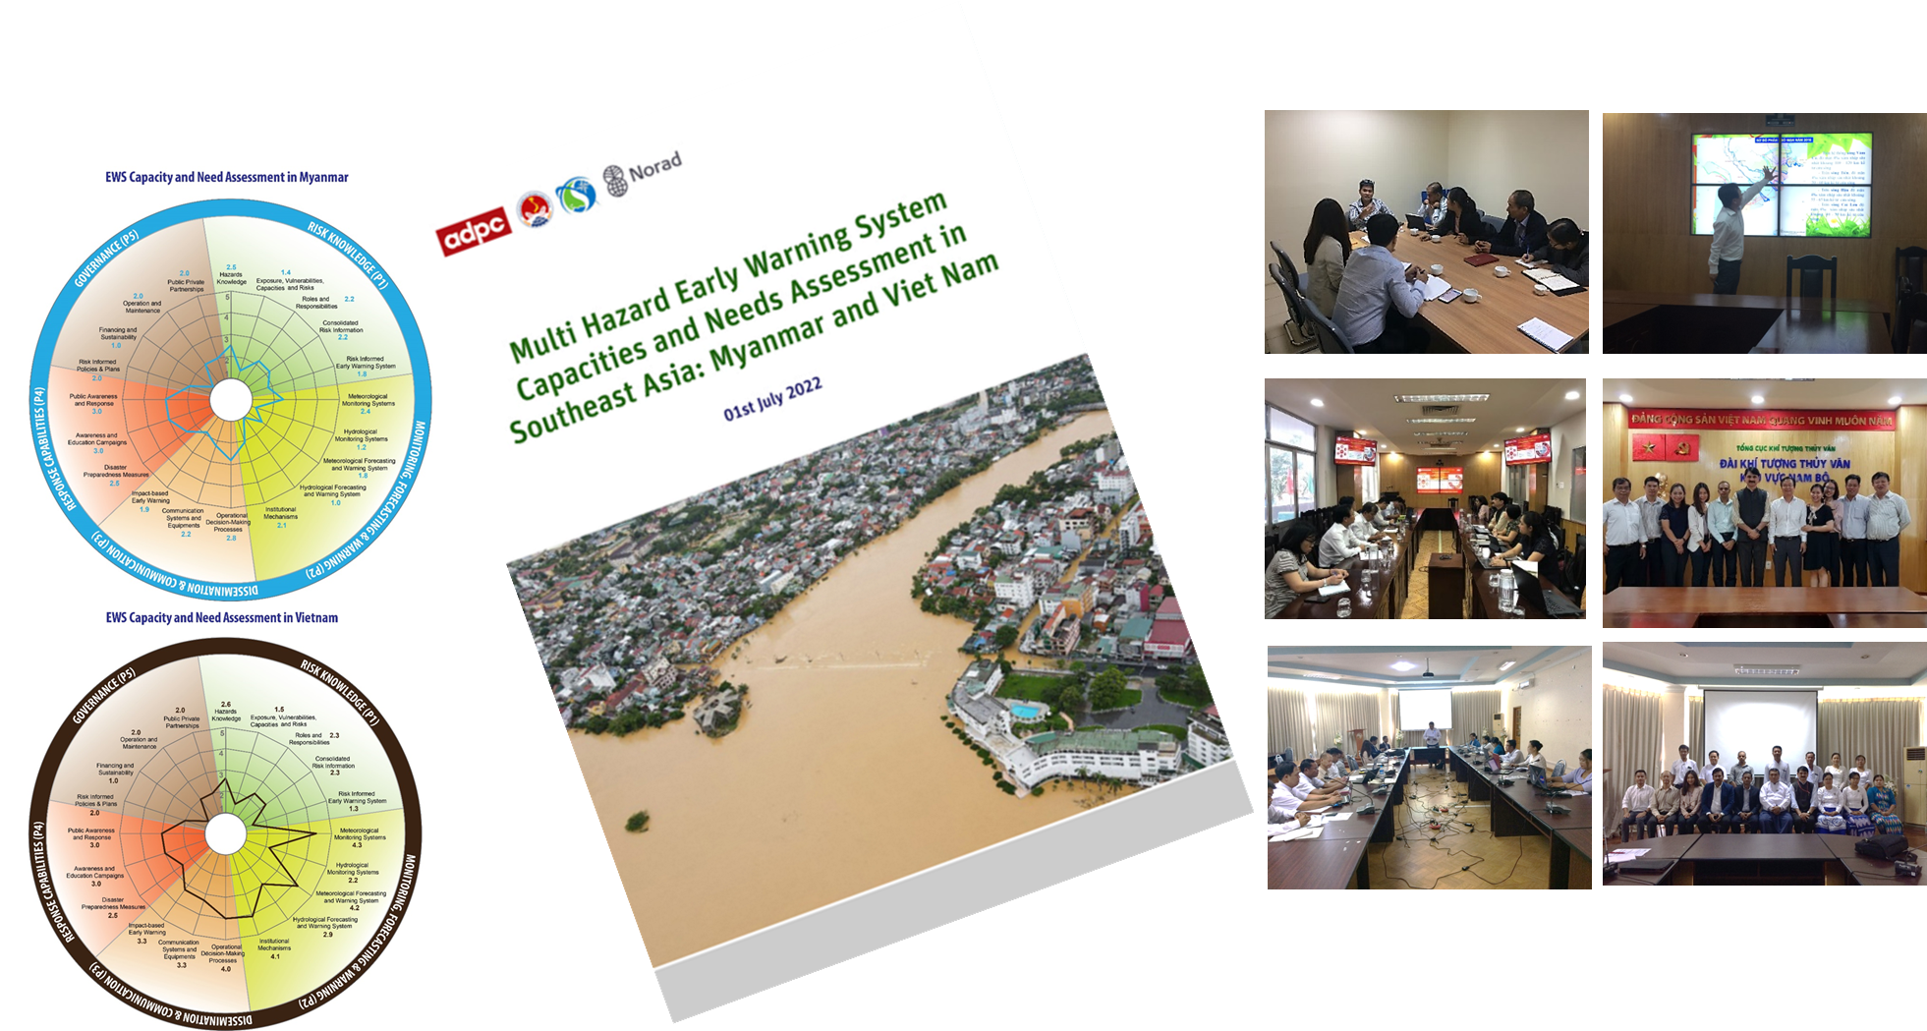
Stocktaking – Southeast Asia:
Cambodia, Myanmar, Viet Nam

Slide 24
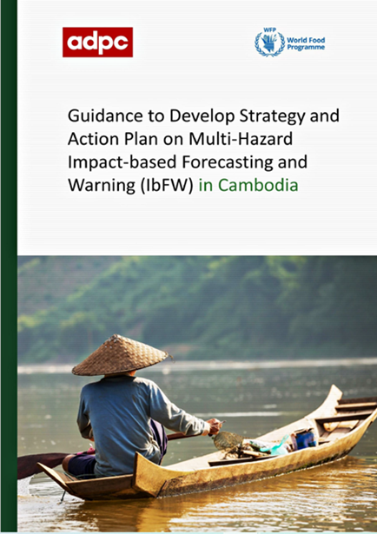
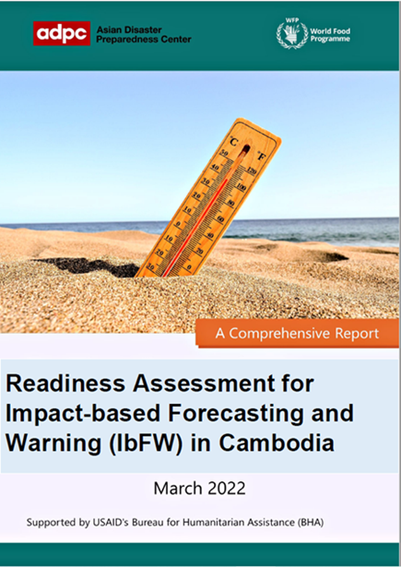
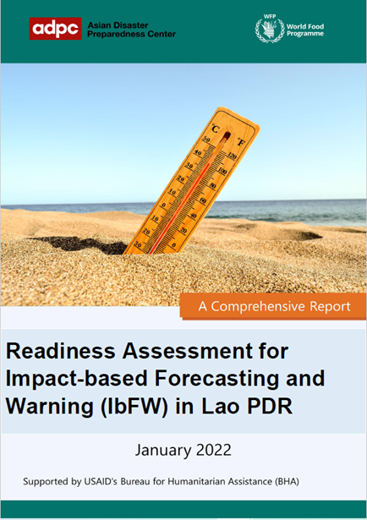
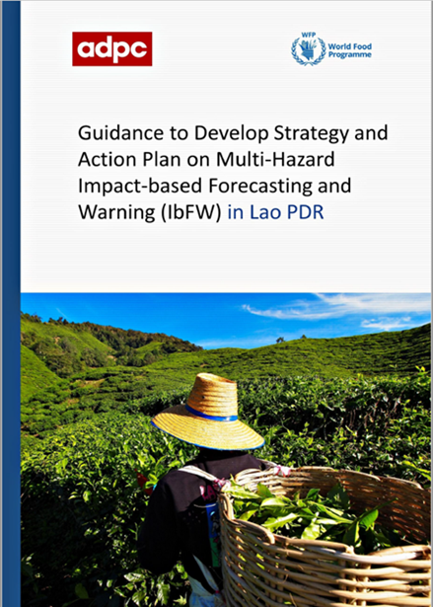
IbFWS Products:
Cambodia and Lao PDR

Slide 25
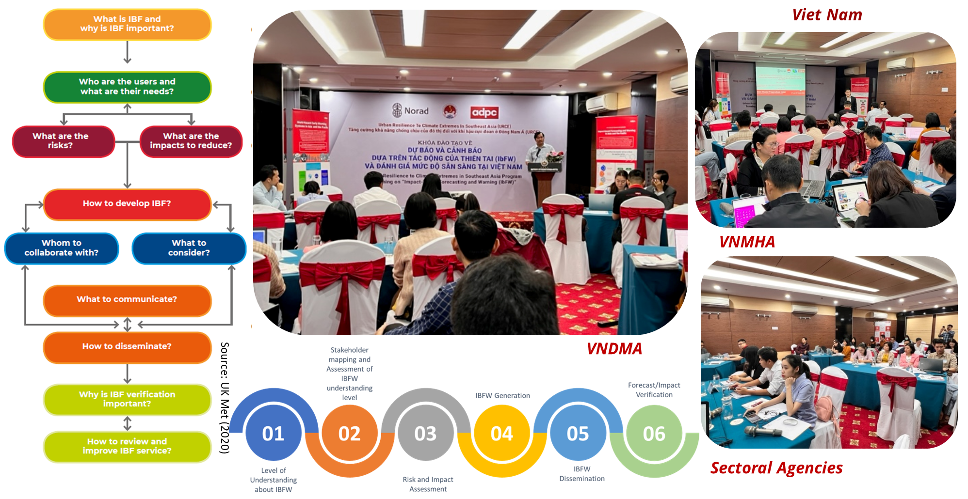
IbFW Readiness Assessment:

Slide 26
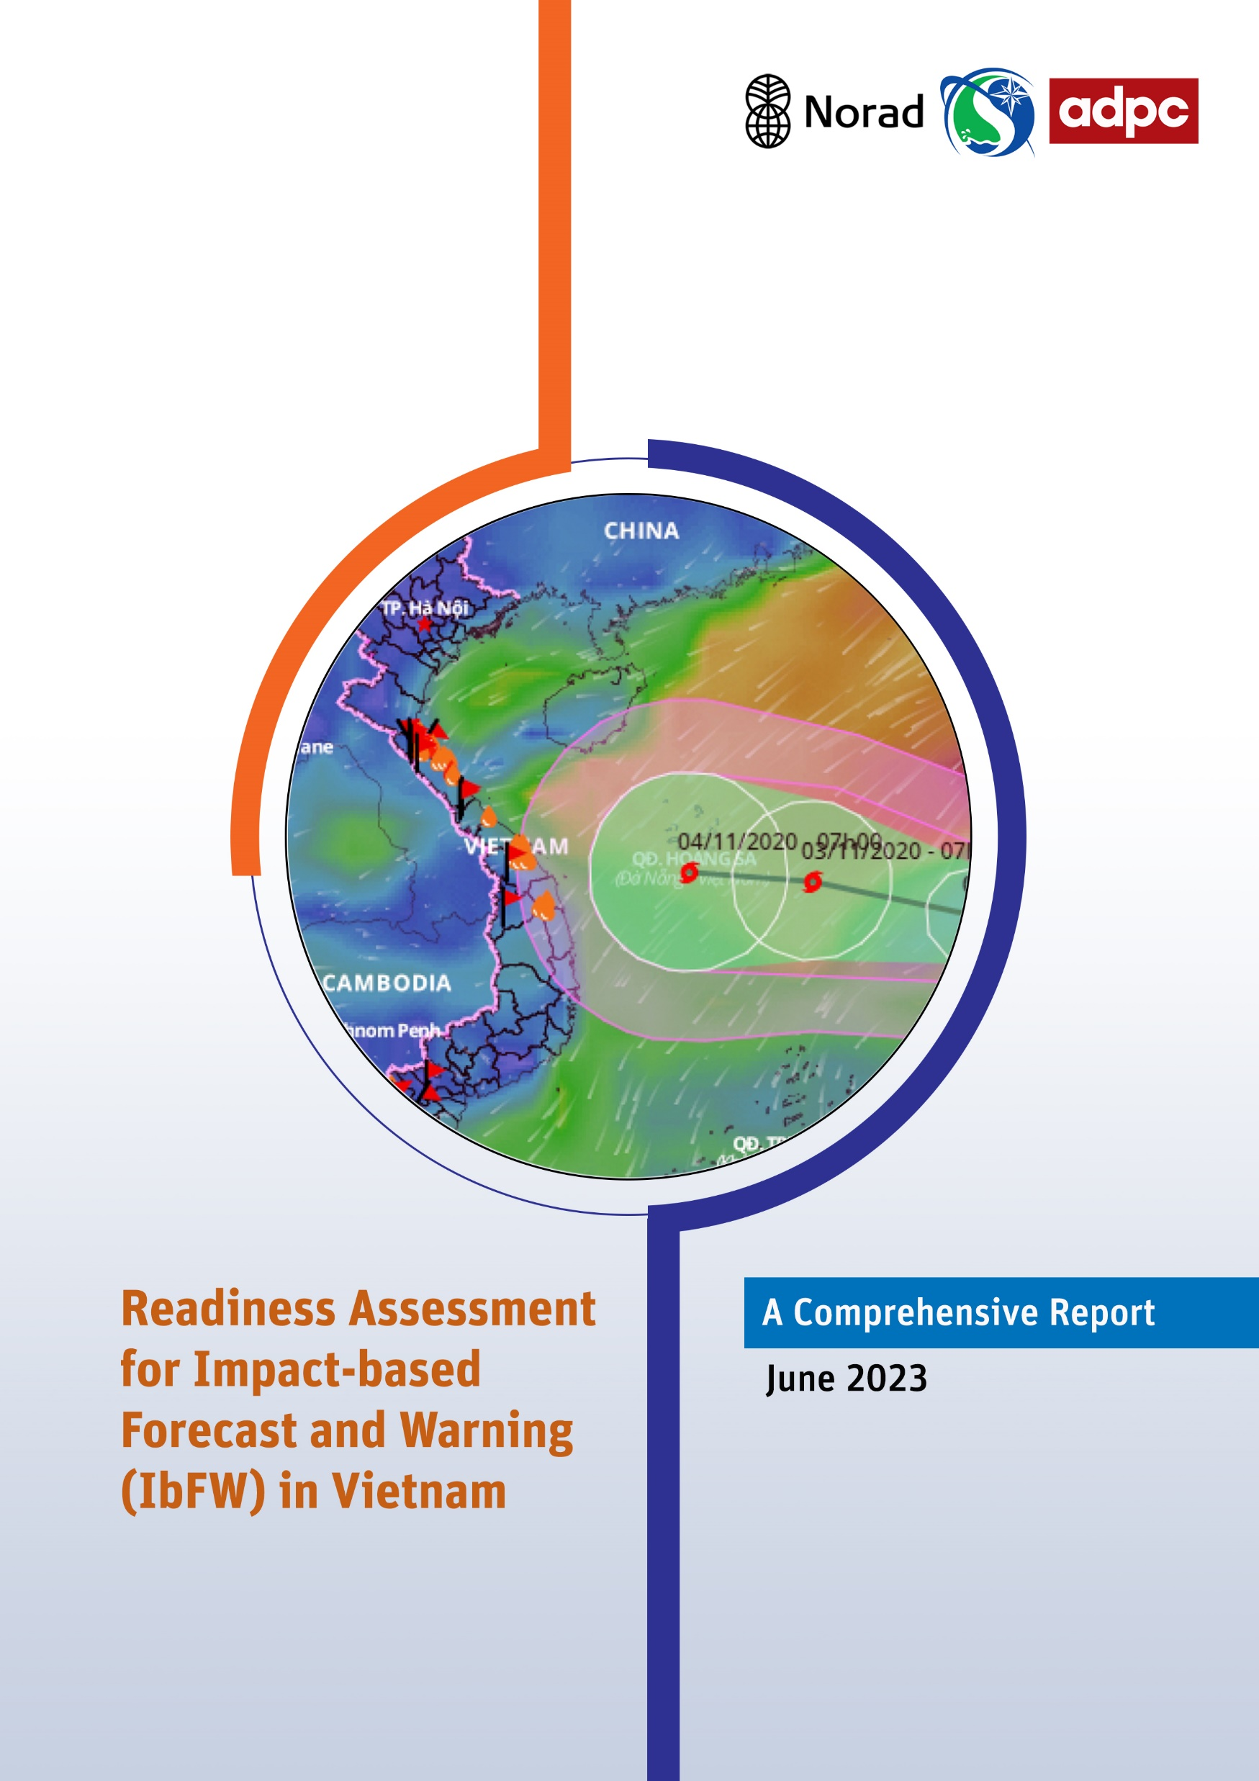
IbFW Readiness Assessment:

Slide 27
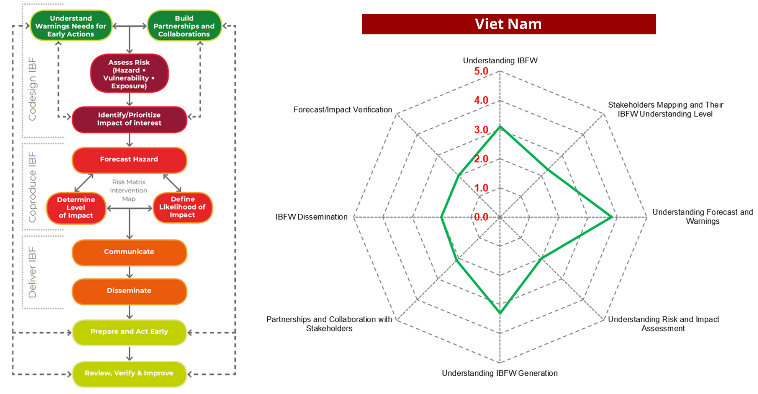
IbFW Readiness Assessment:

Slide 28
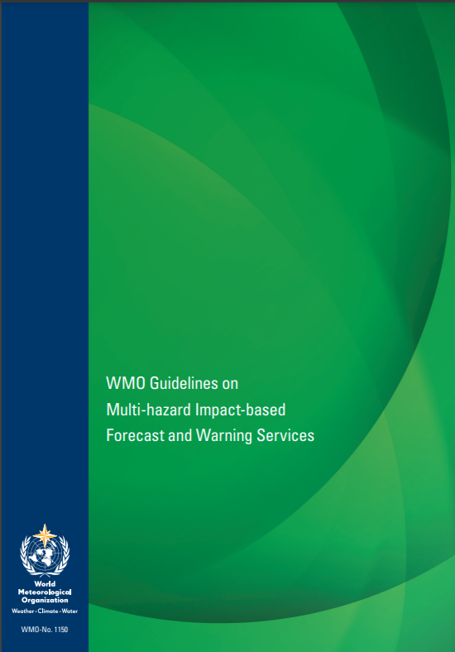
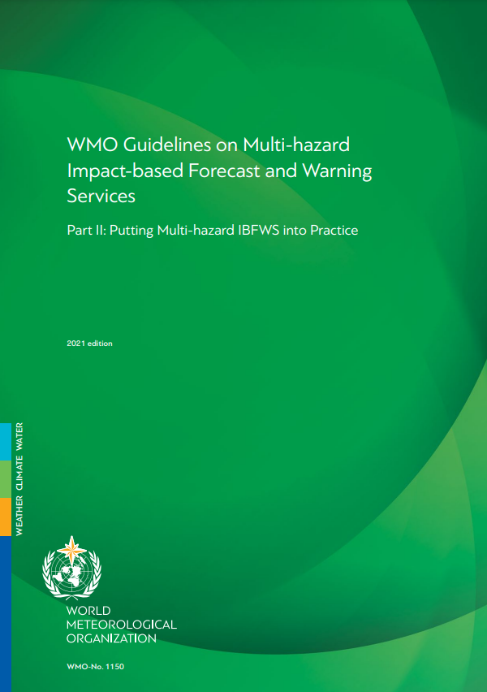
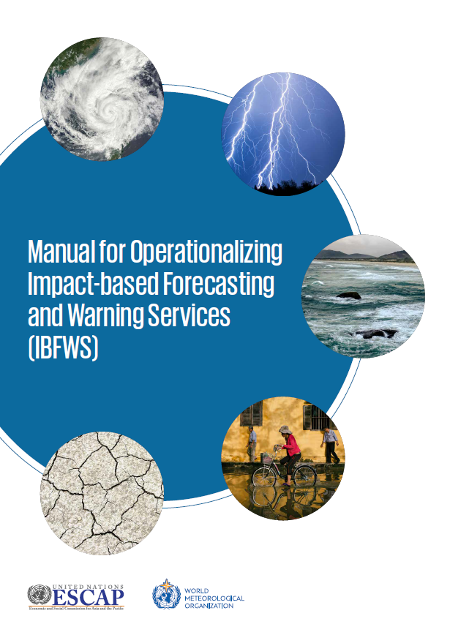
International and Regional Guidelines:
Source: WMO (2015)
Source: WMO (2021)
Source: MET Office, UK (2020)
Source: UNESCAP (2021)

Slide 29
SOP for Cyclones:

Slide 30
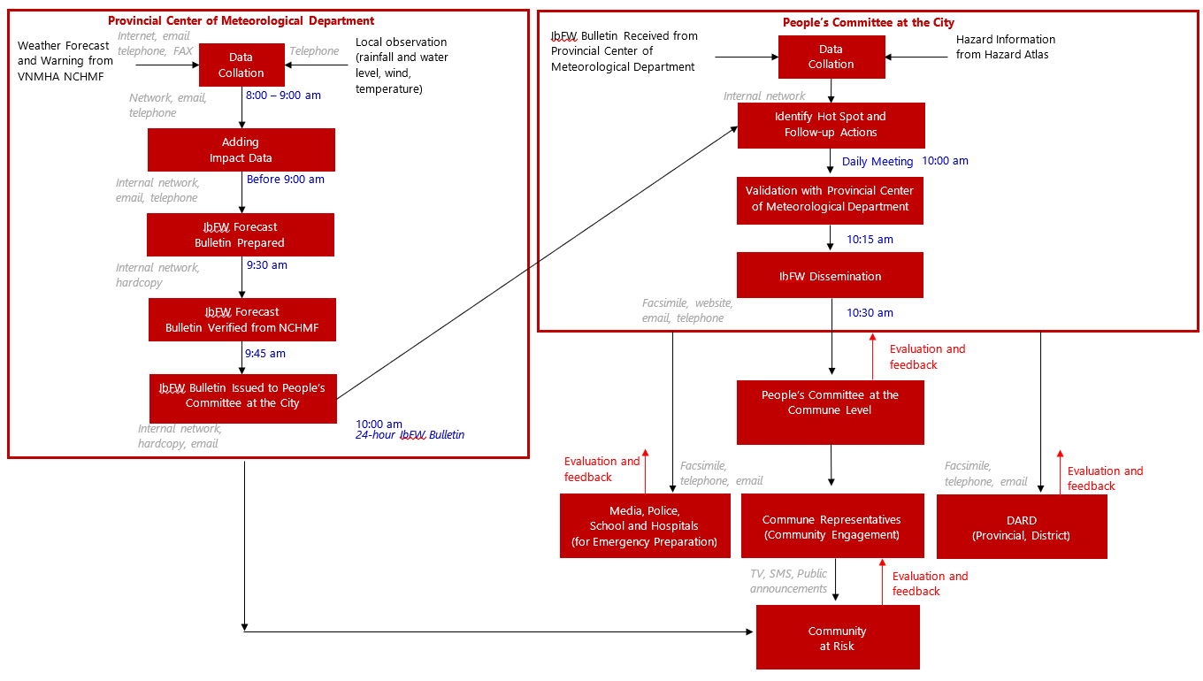
Source: ADPC (2023)

Slide 31
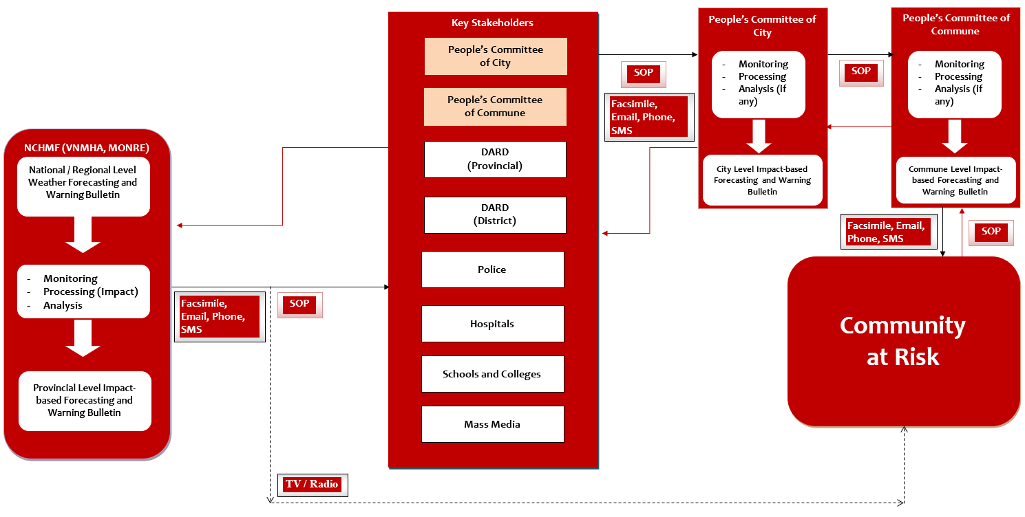
Source: ADPC (2023)

Slide 32
